Slide 1
INTRODUCION OF CLOUD COMPUTING

Slide 2
Cloud Computing
On-demand access to computing resources via the internet
Includes servers, storage, databases, networking, software
Pay-as-you-go model

Slide 3
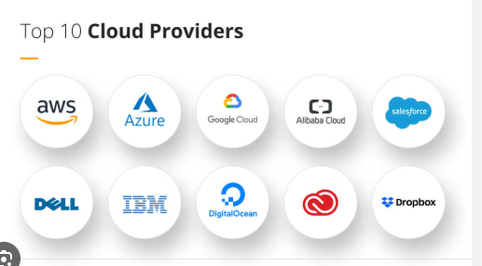

Slide 4
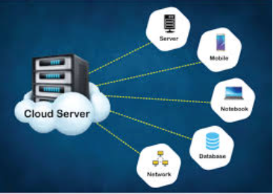

Slide 5
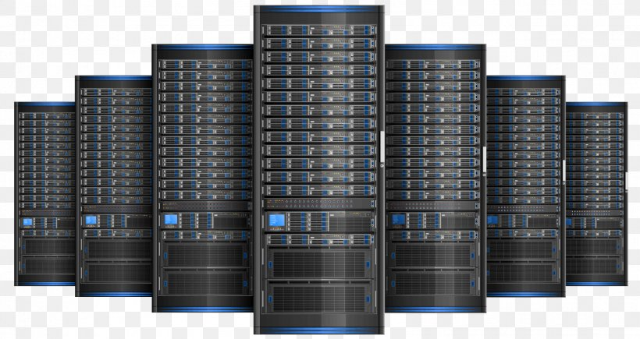

Slide 6
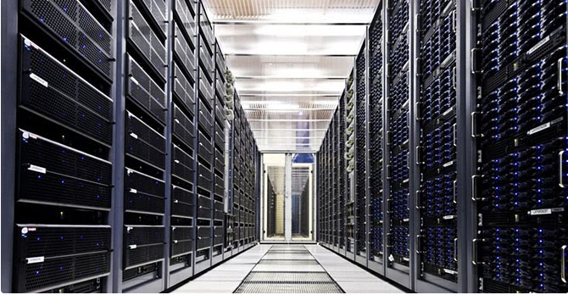

Slide 7
Key Characteristics
On-Demand Self-Service – Use resources anytime
Broad Network Access – Access from anywhere
Resource Pooling – Shared infrastructure
Rapid Elasticity – Scale up/down as needed
Measured Service – Pay only for what you use

Slide 8
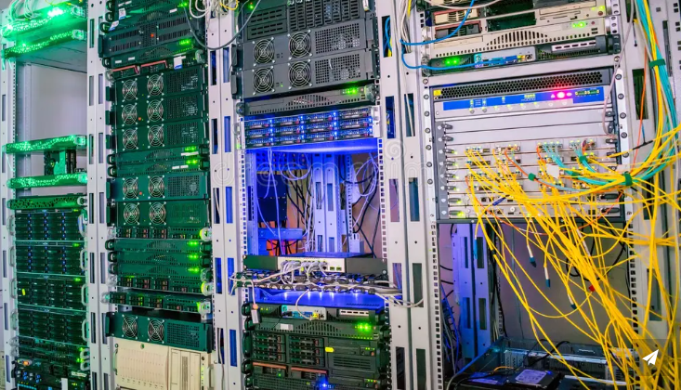

Slide 9
Slide 4: Cloud Service Models
IaaS (Infrastructure as a Service)
Example: AWS EC2, Google Compute Engine
PaaS (Platform as a Service)
Example: Google App Engine, Heroku
SaaS (Software as a Service)
Example: Gmail, Microsoft 365, Dropbox

Slide 10
Slide 5: Cloud Deployment Models
Public Cloud – Available to general public (e.g., AWS, Azure)
Private Cloud – For a single organization
Hybrid Cloud – Mix of public and private
Community Cloud – Shared by similar organizations

Slide 11
Slide 6: Benefits of Cloud Computing
Cost-effective
Scalable
Reliable
Easy to maintain
Accessible from anywhere
Secure (if configured properly)

Slide 12
Slide 7: Challenges
Data security and privacy
Downtime and internet dependency
Compliance and legal issues
Vendor lock-in

Slide 13
Slide 8: Summary
Cloud Computing provides flexible, scalable IT services
It saves cost and time
Used in almost every industry today
Understanding cloud is essential for future careers

